Slide 1
7th Grade Math
Mrs. Tara Stepanian

Slide 2
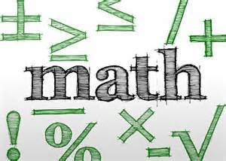
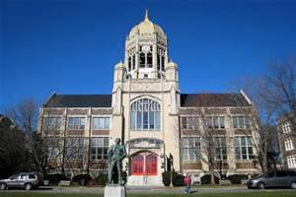
About Me
Bachelor’s Degree - Muhlenberg College
Master’s Degree - The College of Saint Elizabeth
NJ State Certificates:
Math Specialization Grades 5-8
Special Education K-12
Elementary K-8
Science Specialization Grades 5-8
Highly Qualified in Language Arts K-8

Slide 3
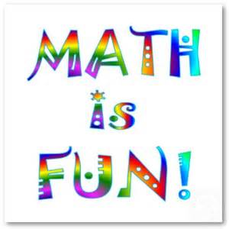
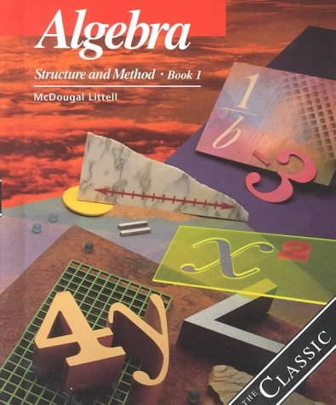
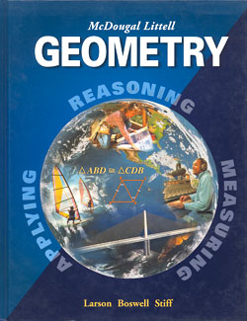
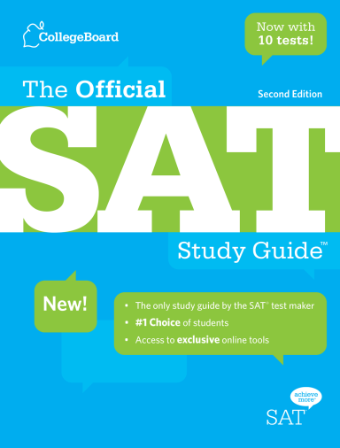
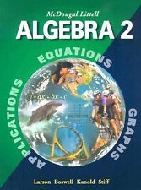
Math Experience Outside of School
Chyten
SAT/ ACT
Algebra I, Algebra II, Geometry, Pre-Calculus

Slide 4
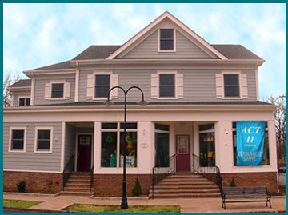
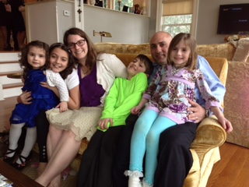
Home Life
Family has resided in LHT for over 30 years
Chatham, NJ

Slide 5
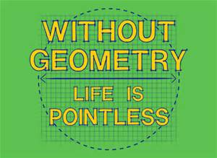
Expectations
Of Students
Prepared
Assignment pad, homework (checked), binder, pencil, expo marker, highlighter
Open Mind
EVERYONE can do math
Respectful

Slide 6
Goals for Students
Confidence
Self-advocate
Effort

Slide 7
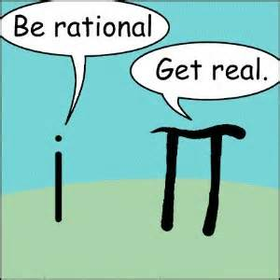
Homework
Given 4-5 days a week
Should not take hours (20-30 min only)
To reinforce skills learned in class
Checked with answer key from the computer
Posted on the website, board, handout
www.longhill.org

Slide 8
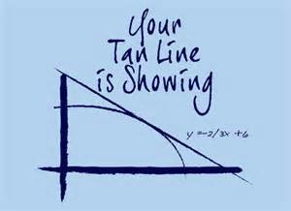
Teacher Contact Information
BEST via email
tstepanian@longhill.org
Phone

Slide 9
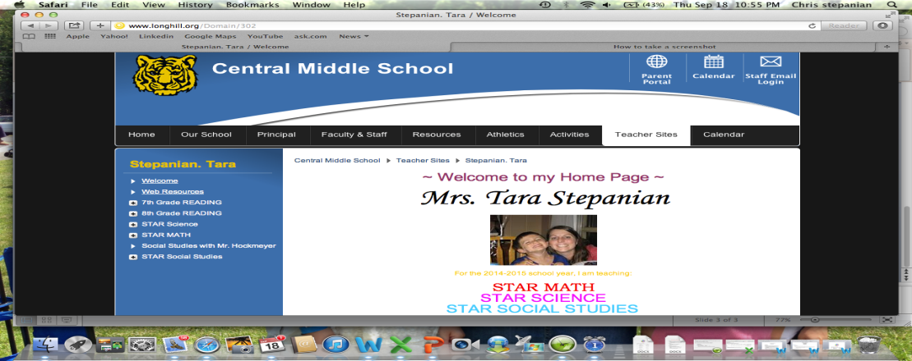
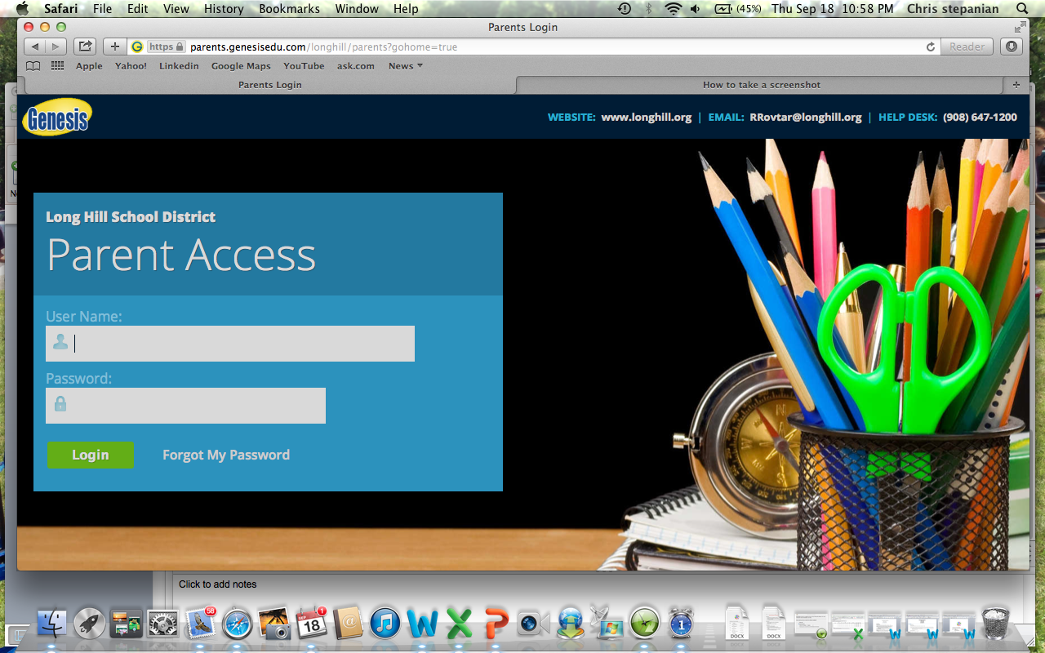
Student Information
Teacher Website:
Genesis:

Slide 10
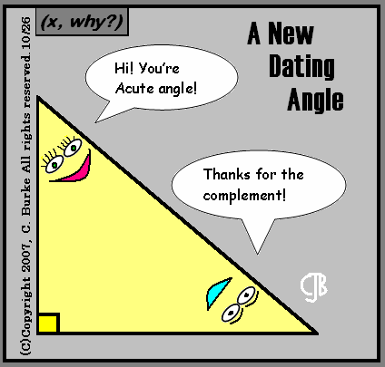
Course Highlights:
*Variable equations and expressions
*Integers
*Extend understanding of fractions
*Proportions
*Interpreting Graphs
*Percents
*Area, Volume and Surface Area
*Probability
*Inequalities
*Slope

Slide 11
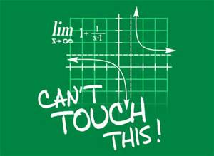
Grading
Grades will be based on Total Points Earned/ Total Points Attempted. The following ranges are approximate for each category:
Tests – 50 to 100 points each
Quizzes – 25 to 50 points each
Classwork – 3 to 20 points each
Projects – 50 to 75 points each
Homework – 3 to 20 points each

Slide 12
I am looking forward to a great year together!

